Slide 1
Codeless test automation
Saurabh Kandhway

Slide 2
Overview and need for Codeless automation
In the early days of software development, almost everything was done manually, from writing code to testing. But as the scale and complexity of software systems grew, manual processes became increasingly impractical, being error-prone. The need for more efficient methods led to the development of automation tools, which could handle repetitive tasks far more quickly and accurately than humans.
What is Codeless Test Automation ?
Codeless automated testing, or codeless automation, is the process of creating automated tests without writing a single line of code. Codeless automation lets teams automate the process of writing tests scripts regardless of skill level.

Slide 3
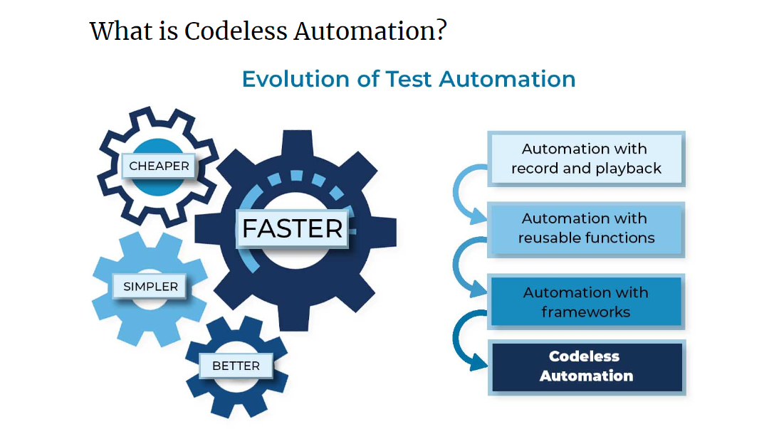
Evolution of codeless test automation

Slide 4
Advantages of codeless automation
User-Friendly UI
Keeps Pace with Development
Lowers Maintenance Cost & Scalability
Increase Automation Adoption
Greater Process & Change Documentation
Smart Element Locators
Conditional Waiting
Ability to Insert Code

Slide 5
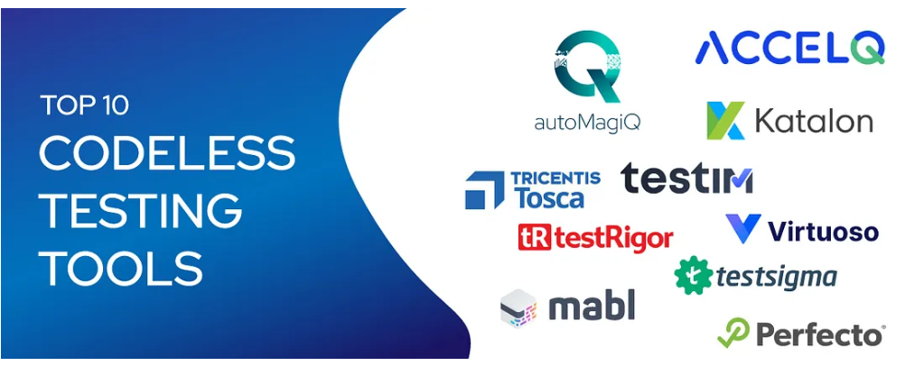
Codeless automation tools

Slide 6

autoMagiQ, a groundbreaking codeless test automation tool that redefines the way testing is performed. With autoMagiQ, you can develop robust, maintainable tests faster, gain actionable insights, and experience the magic of AI-powered Automation.
Following are the features of autoMagiQ
Intuitive and User-friendly UI. Near-zero learning curve for both testers and domain experts.
AI/ML models for proactive failure prediction and RCA.
Cloud-based infrastructure ensuring scalability.
Self-healing capability employs adaptive element identification, addressing run-time issues associated with dynamic application changes and ensuring robust automation execution.
Comprehensive dashboard offering real-time project progress metrics.
Rich integration ecosystem supporting CI/CD.
Multi-environment testing: web, mobile, API, and desktop.

Slide 7

ACCELQ is a test automation tool that leverages the power of artificial intelligence (AI) to automate testing for a wide range of applications, including web, desktop, mobile apps, and mainframes. It seamlessly integrates with DevOps and QA systems, offering a unified perspective of the entire software development lifecycle.
Some key attributes of ACCELQ that help it as a codeless automation testing tool are:
Cloud-based test automation with AI-driven, no-code capabilities.
Rapid test automation development with minimal maintenance requirements.
Empowers continuous testing through Software Development Life Cycle (SDLC) automation.
Rich set of built-in actions for comprehensive test coverage.
Seamless integration with popular tools and platforms.
Comprehensive cross-device and cross-browser testing.

Slide 8

Katalon Studio stands as one of the prominent test automation tools that require no coding expertise. It provides a comprehensive suite of testing features that encompass API testing, web applications, and desktop applications.
The Katalon test automation tool boasts several core features, including:
1. Inclusion of built-in project templates, test case libraries, and object repositories for enhanced test development and management.
2. Facilitating improved collaboration for agile teams through seamless integrations with popular tools like Slack, GitHub, and more.
3. Empowering technical users to craft advanced automation scripts using Selenium or JavaScript for greater flexibility and customization.
4. Support for native plugins tailored for continuous integration, streamlining the automation process within development workflows.

Slide 9

Perfecto stands as an alternative codeless testing platform designed to cater to both web and mobile applications. This cloud-based testing solution extends its support across a multitude of user devices, browsers, and operating systems.
The tool harnesses the power of artificial intelligence (AI) to optimize the Continuous Integration/Continuous Deployment (CI/CD) pipeline. One of its noteworthy functionalities lies in self-healing, where automated test scripts run seamlessly, avoiding any interruptions
Listed below are some of the fundamental attributes of the Perfecto test automation tool:
Offers enterprise-grade security and scalability.
Leverages AI-based maintenance capabilities.
Utilizes AI and machine learning to automatically generate Selenium test scripts.

Slide 10

Tosca is an automation tool grounded in model-based testing and enriched with productivity enhancements like UI and API scanning.
Crafted for the world of continuous testing, Tosca boasts compatibility with over 160 technologies, achieving an impressive 90% automation rate. Beyond this, the tool encompasses various functionalities, including automated units, test management, and code integration, enabling efficient and swift testing
Highlighted below are some key features of the Tosca automation tool:
Seamlessly integrates with test management, graphical user interface (GUI), command-line interface (CLI), and application programming interface (API).
Embraces a model-based approach that caters to the needs of business users, simplifying the testing process.
Offers an intuitive user interface for the creation of automation test cases, eliminating the need for programming skills.
Boasts a reusability feature for efficiently testing core components.

Slide 11

TestRigor stands as a no-code testing solution, empowering manual QA testers to craft intricate automated tests using simple, plain English commands. This versatile tool extends its support to an array of testing domains, including Web UI, Native and Hybrid Mobile apps, Mobile browsers, and APIs. It offers a level of flexibility that enables testers to develop tests more swiftly compared to using Selenium.
Key Features:
TestRigor’s no-code commands and tests are designed for easy comprehension and utilization by individuals of all backgrounds.
It seamlessly integrates with CI/CD systems and test case management tools, streamlining the testing process.
The tool provides comprehensive cross-platform and cross-browser support.
It is capable of executing thousands of tests and delivering results in under 30 minutes, ensuring efficiency and timely feedback.

Slide 12

TestIM is a comprehensive AI-driven testing platform that facilitates test automation in a straightforward, stable, and collaborative manner. It employs dynamic and intelligent locators to adapt to any alterations in the Application Under Test (AUT), allowing for the automatic generation and execution of tests.
Key Features:
TestIM’s intelligent and adaptable locators are capable of autonomously generating tests, enabling teams to keep pace with rapidly evolving releases and UI modifications.
It seamlessly integrates with existing CI/CD pipelines and collaboration tools.
TestIM’s visual test editors simplify test creation, making it accessible even to non-technical team members.
The platform provides comprehensive test reports and bug checkers, facilitating a thorough analysis of the testing process.

Slide 13

Agile teams frequently encounter the challenge of delivering high-quality releases quickly. In such a scenario, codeless test automation platforms like TestSigma prove to be invaluable, permitting users to create, execute, troubleshoot, and assess self-repairing tests in plain and straightforward English.
Key Features
Simplified test creation through natural language commands.
Self-repairing tests employing an intelligent algorithm that identifies and rectifies page element issues.
Comprehensive test reports to pinpoint trends in quality.
Inbuilt integrations with popular tools such as Jira, Jenkins, GitHub, and Slack.
Visual testing capabilities for the detection of visual discrepancies across diverse browsers, devices, and operating systems.

Slide 14

Virtuoso represents an AI-driven platform that empowers you to automate your end-to-end testing process, all without the need for coding, even when dealing with the most dynamic applications. It enables the execution of tests on a grand scale in the cloud, across various devices, browsers, and operating systems
Key Features:
Creation of functional tests using Natural Language Programming for enhanced accessibility.
Employing Intelligent Object Identification for self-sustaining tests that require minimal upkeep.
Leveraging AI-driven self-healing capabilities to reduce the necessity for ongoing test maintenance.
Execution of cloud-based tests on a multitude of devices, browsers, and operating systems, all at scale.

